Slide 1




AUTOMOBILE DEALER MANAGEMENT SYSTEM
SUMMER TRAINING
INDEPENDENT MINI PROJECT

Slide 2
HELLO!
I am Soham Chakravorty
I am here to present the mini project on “Automobile Dealer Management System”

Slide 3
Introduction
Flow of Program
01
04
Project Uses
Languages Used
02
05
Description
Summary
03
06
Overview of the project
The work flow of the program indicating the sequential order
The application of the project
Programming languages used in the project
The basic idea behind the project
Summarized result of the project and the desired output

Slide 4

01
INTRODUCTION

Slide 5
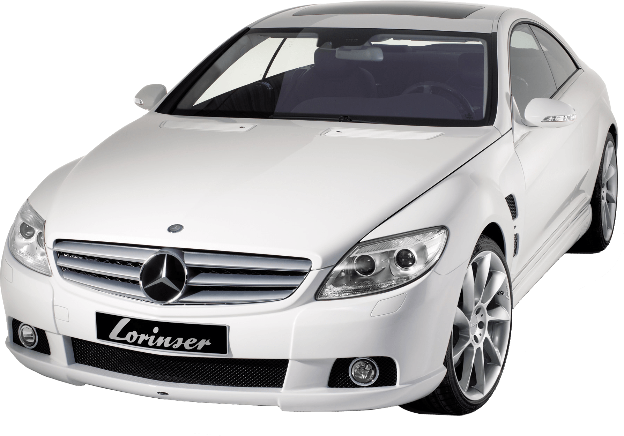
MISSION STATEMENT
The mission or the key objective of this project is to aid the problems and difficulties faced in the automobile sector, ranging from easy, fast entry of data to getting an output of the records from the database in seconds.

Slide 6
PROBLEM VS. SOLUTION
Problem
Solution
Time vs Work Load
Loss of data
Human Errors
Delayed Data Lookup & Processing
One software which comprises of various functions which facilitates the work of an automobile dealership ultimately improving it’s efficiency & productivity

Slide 7

02
PROJECT USES
This Photo by Unknown Author is licensed under CC BY-NC

Slide 8

PROJECT USES
The major operations and manipualation services such as insertion, retrieval & deletion of data are operated on the following functions:
Details of Customers
Details of Employees
Available Car Brands
Available Car Details
Invoice Details
Payment Information

Slide 9

03
DESCRIPTION

Slide 10

DESCRIPTION
The project “Automobile Dealer Management System” deals with the real life scenarios and difficulties which are faced in day to day routine which ultimately aids and increases the productivity and efficiency of the dealership ensuring quality in terms of service to each and every customer. The automated system reduces the hassle of maintaining records, its manipulation and searching. The project is created using Python & MySQL. The system consists of various functions such as data entries, data display as well as data deletion of records of multiple tables which is stored under its database.

Slide 11

04
FLOW OF PROGRAM

Slide 12
FLOW OF PROGRAM
STEP 1
STEP 2
STEP 3
STEP 6
STEP 5
STEP 4
START
SERVICE SELECTION AS PER REQUIREMENT FROM HOMEPAGE
AS PER CHOSEN SERVICE, FUNCTION SELECTION
END OF PROGRAM OR CONTROL RETURNS TO THE START
GENERATION OF OUTPUT
INJECTION/FETCHING/ DELETION OF DATA INTO/FROM THE DATABASE

Slide 13
05
LANGUAGES USED

Slide 14


LANGUAGES USED
Python 3.10 & MySQL are used for the project.
The front end or user interactive interface is created using python & the backend where the data is stored also known as database is created using a DBMS called MySQL.
The connection between the languages is established using the MySQL Connector

Slide 15
06
SUMMARY

Slide 16
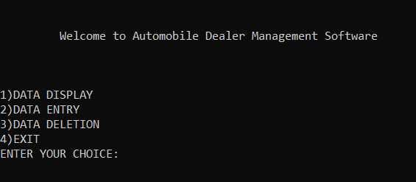
SUMMARY
The adjoining figure shows the first display screen of the software also known as the home page. It consists of 3 major service selection choices based on which further functions are customised within the program to give the desired result.
Fig: Main Program Interface / Homepage

Slide 17
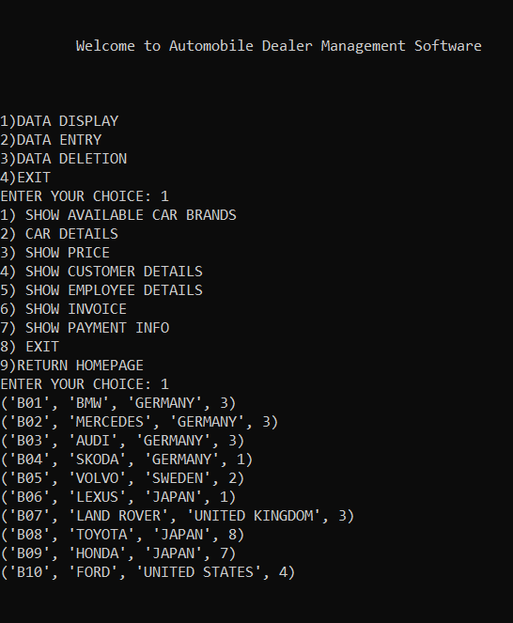
SUMMARY
The adjoining figure shows the Data Display service of the software. It consists of various function selection choices based on the tables and its services in the database. The figure shows data retrieval from database without the purpose of providing any key value and hence all the records are displayed.
Fig: Data Display w/o Using Key Value

Slide 18
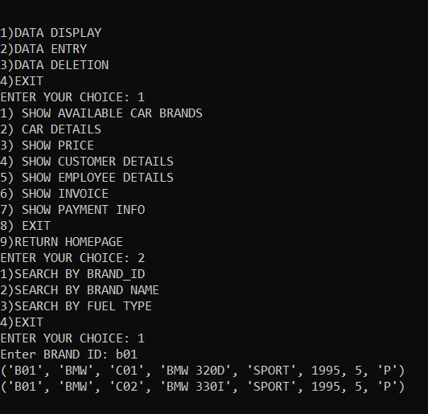
SUMMARY
The adjoining figure shows the Data Display service of the software. It consists of various function selection choices based on the tables and its services in the database. The figure shows data retrieval from database using a key value and hence all the records are displayed when a key value is entered by the user and if record exists for that key value pair, then the data is displayed.
Fig: Data Display Using Key Values

Slide 19
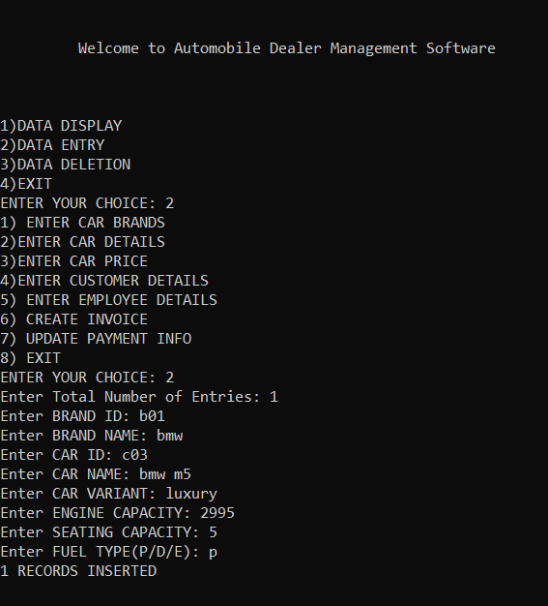
SUMMARY
The adjoining figure shows the Data Entry service of the software. It consists of various function selection choices based on the tables and its services in the database. The figure shows data injection into the database. The program prompts for the required data field value and accordingly the data is entered by the user and upon hitting the final value, the data is inserted into the database in the respective table assigned for it
Fig: Data Entry

Slide 20
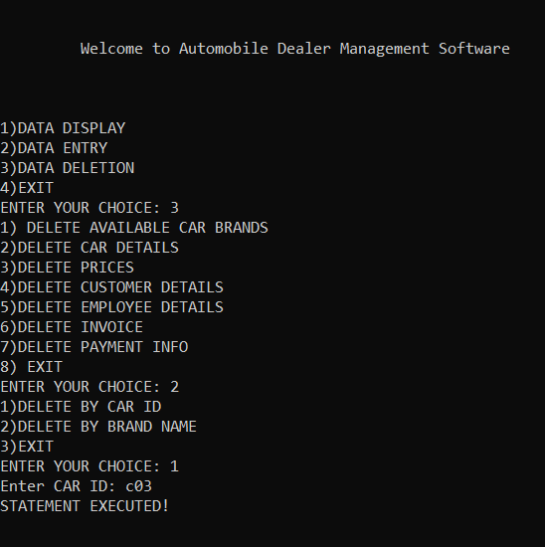
SUMMARY
The adjoining figure shows the Data Deletion service of the software. It consists of various function selection choices based on the tables and its services in the database. The figure shows data deletion from database using a key value which helps to locate the particular row/rows and is used to delete the record of that particular key value pair.
Fig: Data Deletion

Slide 21

SUMMARY
The main aim of this project to create a software which increases efficiency and productivity along with reducing the human prone errors. The automation of the tasks eases the complexity and helps in storage of huge data without any hassle. Data Lookups is one of the major task which is simplified using the software. The services which are provided in the software, can ease the work and reduce the time of processing to a great extent. Multiple data entry & fetching at once service is also available under many functions. This project has been a rewarding experience in more than one way.

Slide 22
THANKS!
Do you have any questions?
21BCS1685@CUCHD.IN

